Slide 1
Reactions 7
D. Observed Resonance Phenomena

Slide 2














































Slide 3










































Slide 4

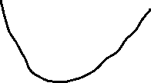






















integer
occupancy

Slide 5













































Slide 6
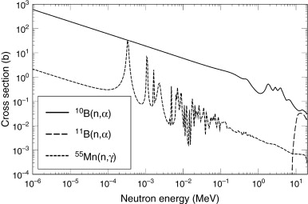















Slide 7












































Slide 8

































Slide 9

























Slide 10









































Slide 11




































Slide 12














Slide 13



































Slide 14
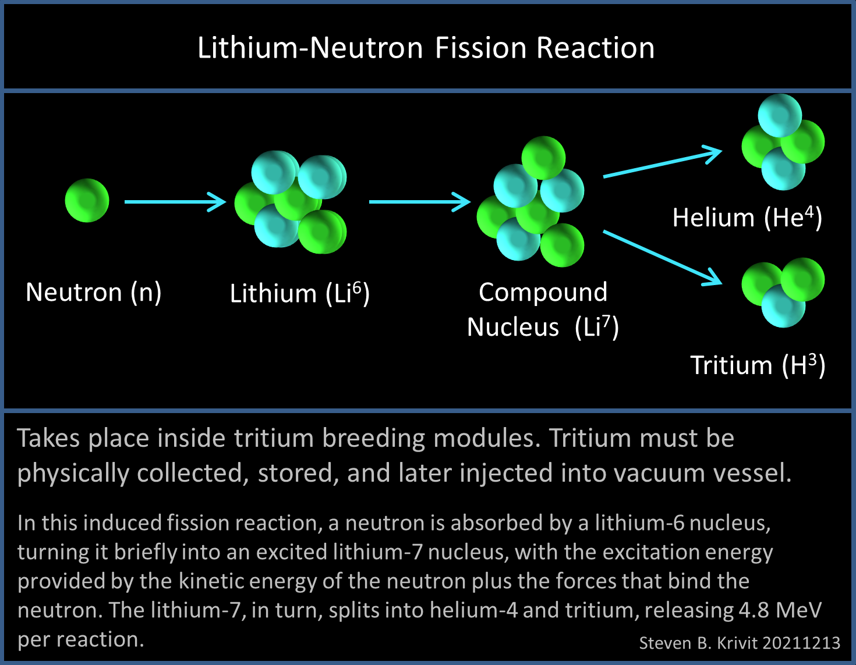

Slide 15
